Slide 1
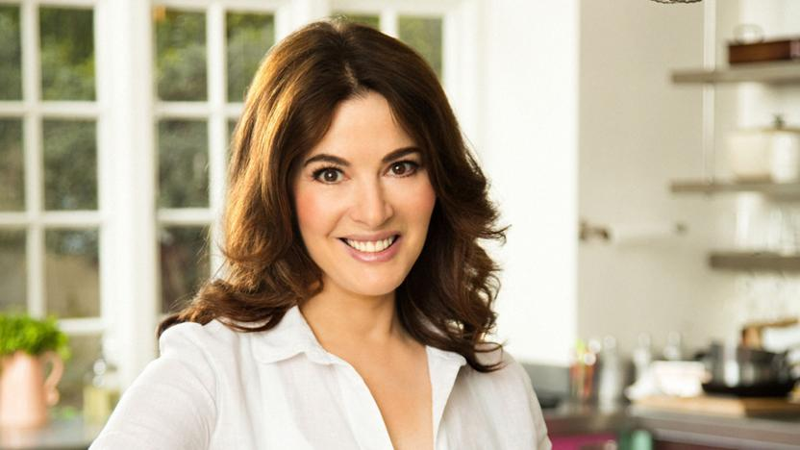
Nigella Lawson

Slide 2
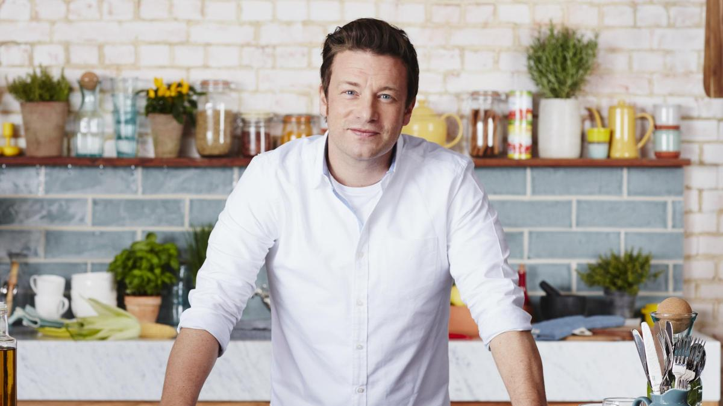
Jamie Oliver

Slide 3
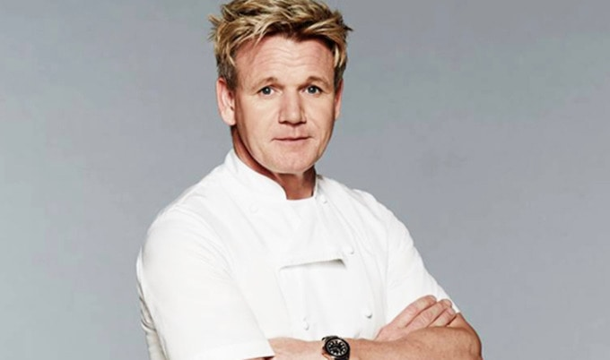
Gordon Ramsay

Slide 4
Rachael Ray

Slide 5
Bobby Flay

